Slide 1
WENDOVER AIRFIELD
FISCAL NOTE REVIEW | IGG SUBCOMMITTEE | 11.15.2019

Slide 2
Utah State Code 63J-1-220
(2) A state agency may not provide a recipient entity state money through pass through funding unless:
the state agency enters into a written agreement with the recipient entity; and
The written agreement described in Subsection (2)(a) requires the recipient entity to provide the state agency:
a written description and an itemized report at least annually detailing the expenditure of the state money, or the intended expenditure of any state money that has not been spent; and
A final written itemized report when all the state money is spent.

Slide 3
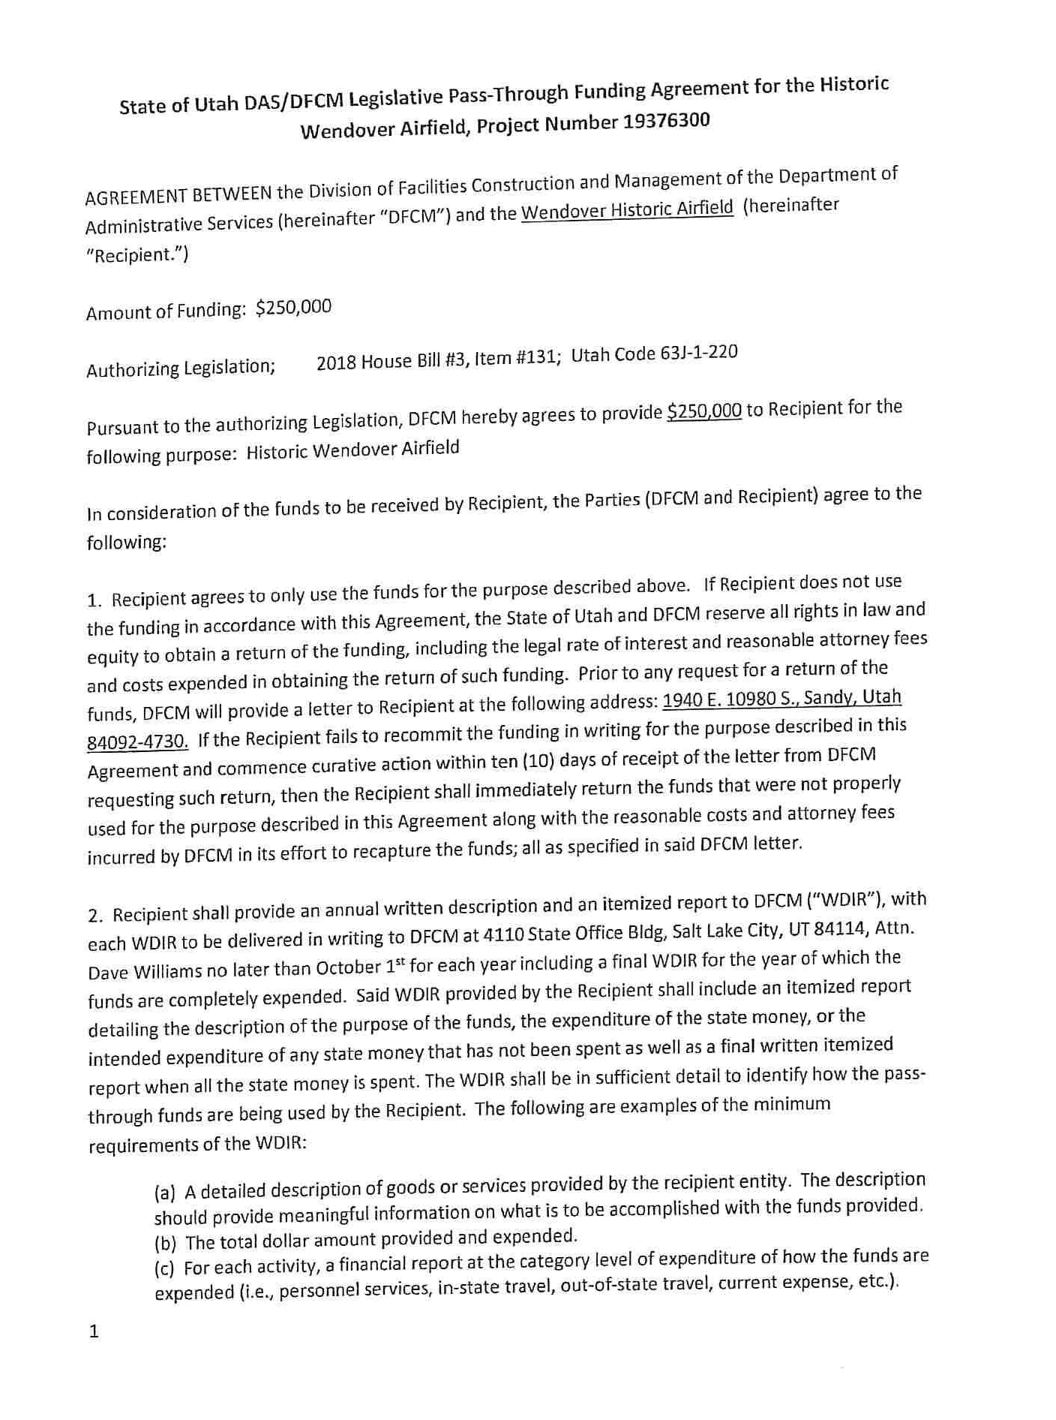
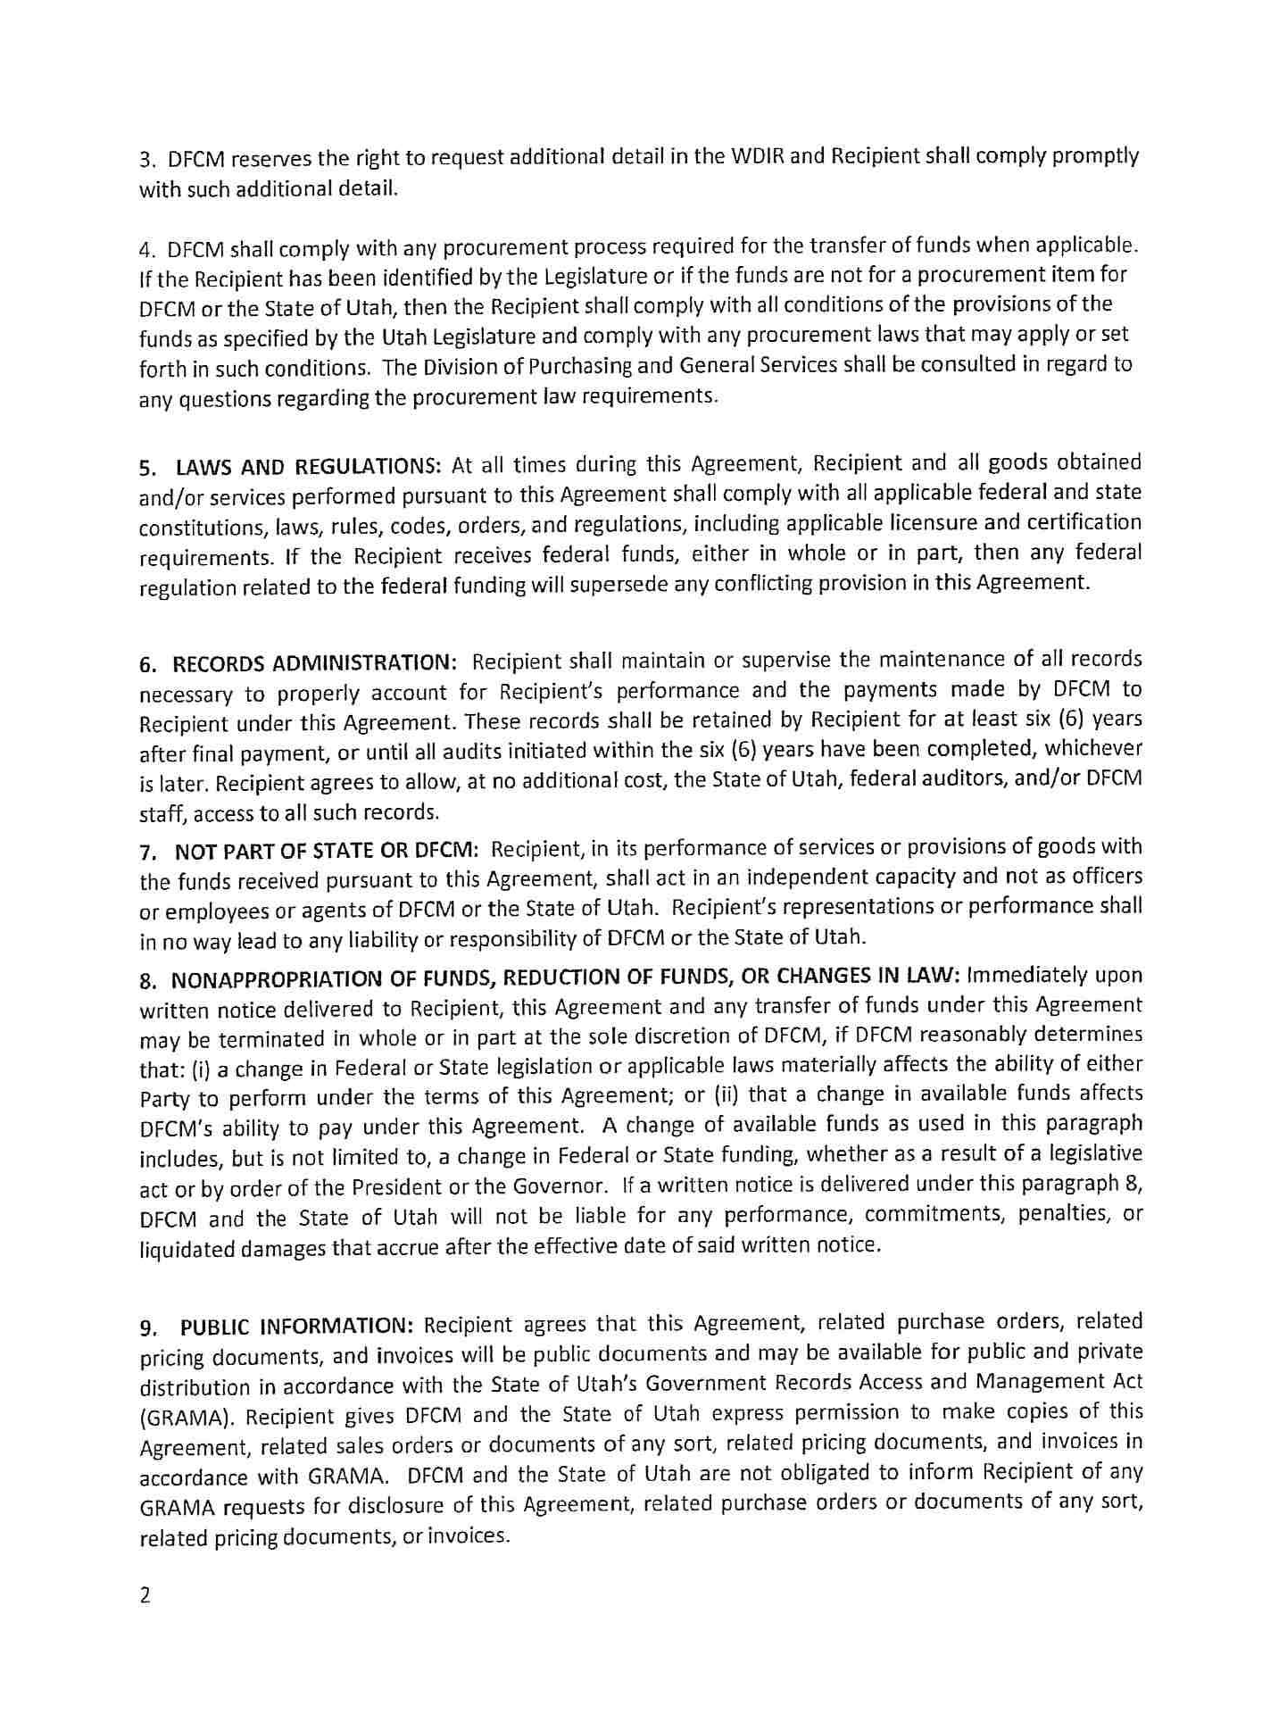
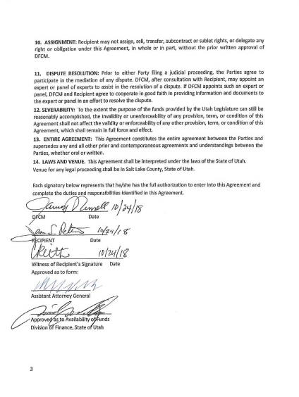
Utah State Code 63J-1-220
(2) A state agency may not provide a recipient entity state money through pass through funding unless:
the state agency enters into a written agreement with the recipient entity; and
The written agreement described in Subsection (2)(a) requires the recipient entity to provide the state agency:
a written description and an itemized report at least annually detailing the expenditure of the state money, or the intended expenditure of any state money that has not been spent; and
A final written itemized report when all the state money is spent.

Slide 4
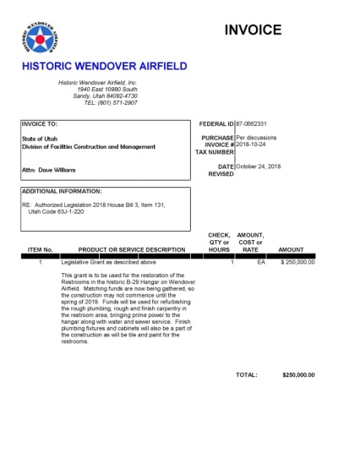
Utah State Code 63J-1-220
(2) A state agency may not provide a recipient entity state money through pass through funding unless:
the state agency enters into a written agreement with the recipient entity; and
The written agreement described in Subsection (2)(a) requires the recipient entity to provide the state agency:
a written description and an itemized report at least annually detailing the expenditure of the state money, or the intended expenditure of any state money that has not been spent; and
A final written itemized report when all the state money is spent.
Written Description

Slide 5
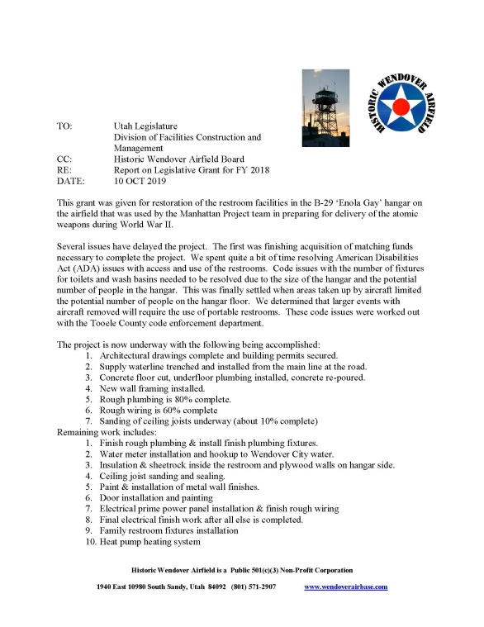
Utah State Code 63J-1-220
(2) A state agency may not provide a recipient entity state money through pass through funding unless:
the state agency enters into a written agreement with the recipient entity; and
The written agreement described in Subsection (2)(a) requires the recipient entity to provide the state agency:
a written description and an itemized report at least annually detailing the expenditure of the state money, or the intended expenditure of any state money that has not been spent; and
A final written itemized report when all the state money is spent.
Written Description
Yearly Report

Slide 6
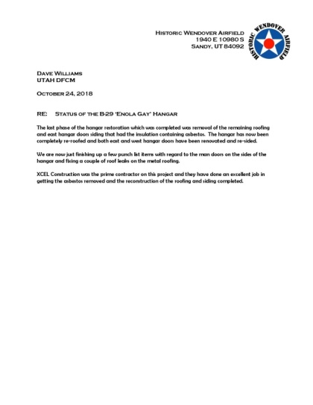
Utah State Code 63J-1-220
(2) A state agency may not provide a recipient entity state money through pass through funding unless:
the state agency enters into a written agreement with the recipient entity; and
The written agreement described in Subsection (2)(a) requires the recipient entity to provide the state agency:
a written description and an itemized report at least annually detailing the expenditure of the state money, or the intended expenditure of any state money that has not been spent; and
A final written itemized report when all the state money is spent.
Written Description
Yearly Report
2017 GS Final Report

Slide 7
QUESTIONS

