Slide 1
Salt Lake City Road Home
Land Bank Acquisition
February 12, 2019

Slide 2
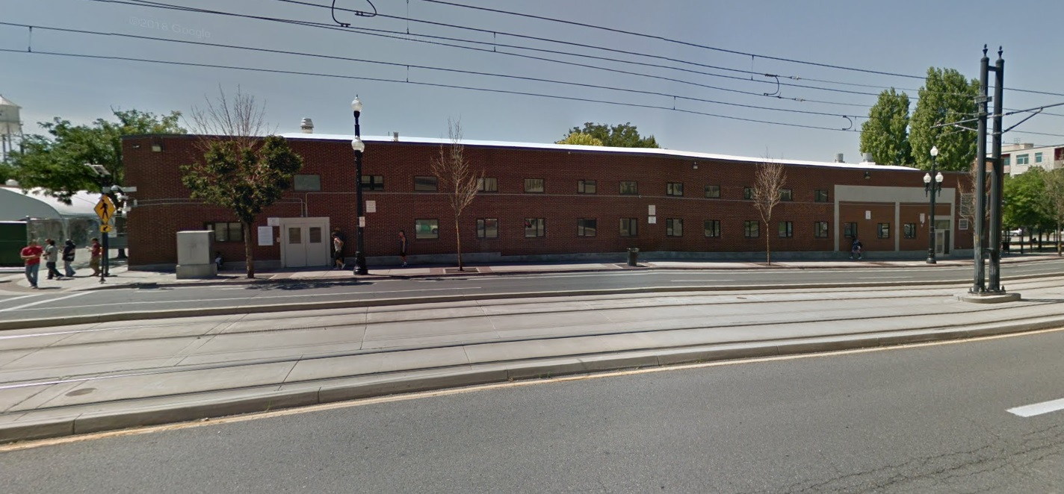
Land Bank Acquisition
The Road Home | 210 South Rio Grande Street
1 | 4

Slide 3
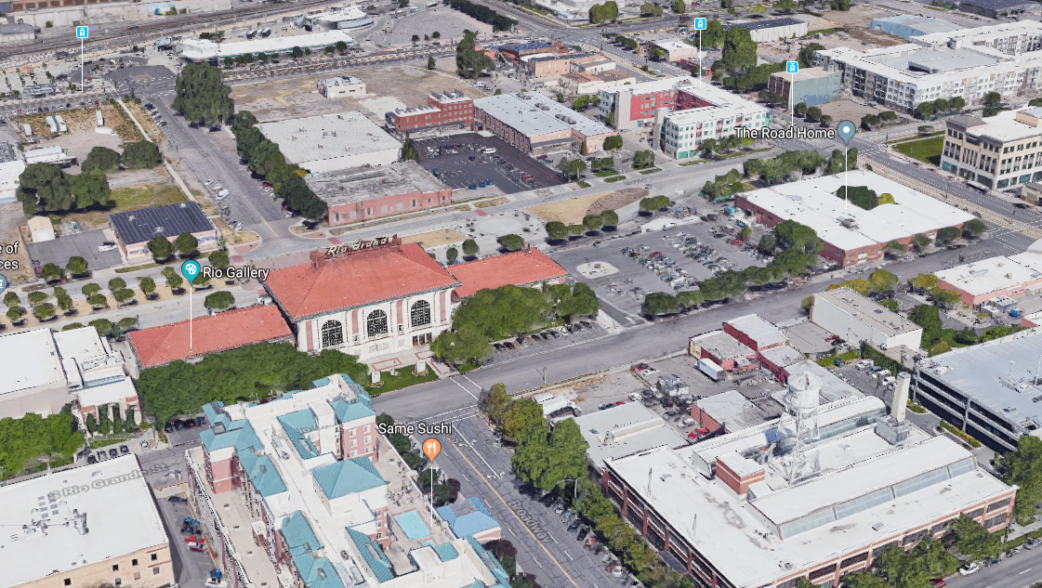
Land Bank Acquisition
The Road Home | 210 South Rio Grande Street
2 | 4
1 | 3

Slide 4
Land Bank Acquisition
The Road Home | 210 South Rio Grande Street
Property Purchase | $4,000,000
Hazmat abatement, demo, fencing, and make safe | $1,400,000
Total Funding Request | $5,400,000
3 | 4

Slide 5
Questions
4 | 4

Slide 6
Springville School for the
Deaf and Blind
February 12, 2019

Slide 7
Funding Timeline
2016
General Session
2017
General Session
2018
General Session
2019
Request
USDB requested one-time $1.2M for site identification & acquisition
Awarded $700K
USDB requested one-time $10.5M for design & construction
32,000 square feet
14 classrooms
Teacher workspaces
Playground
Fleet parking
Awarded $10.5M
Requested $713K one-time funding to cover escalating material and construction costs
USDB had to scale back to
13 classrooms and eliminate a connecting hallway. Funds support project completion as originally designed
Awarded $713K
Earthwork has started and vertical construction will begin in March
DFCM & USDB are requesting $3M to cover rising labor and material costs
1 | 6

Slide 8
Property Costs
Property acquisition cost | $693,781
Impact and connection fees | $259,440
Offsite city-required improvement | $415,000
Soil remediation | $600,000
Total Property & Site Cost | $1,968,221
2016 General Session appropriation |  | $700,000
Funding Shortfall | $1,268,221
2 | 6

Slide 9
Construction Costs
Construction & soft costs | $15,923,804
Total Construction Costs | $15,923,804
2017 General Session appropriation |  | $10,500,000
2018 General Session supplemental appropriation |  | $713,000
USDB funds |  | $1,025,000
Funding Subtotal |  | $12,238,000
Value Engineering | ($1,958,879)
Funding Shortfall | $1,726,925
3 | 6

Slide 10
Funding Shortfall
Property funding shortfall | $1,268,221
Construction funding shortfall | $1,726,925
Total Funding Shortfall | $2,995,146
4 | 6

Slide 11
Remove recess in slab | $500
Remove 14 trees | $2,800
Remove landscape curb | $3,530
Remove irrigation portables | $2,000
Lower playground allowance | $50,000
Change pavers from stain to stamp | $20,000
Remove wooden boardwalks | $50,000
Remove 2 exterior basketball hoops | $4,000
Remove bench pad at 5 locations | $1,000
Reduce plant quantity by 25% | $12,089
Remove plants and replace with grass | $7,000
Remove surcharge | $40,000
Remove vegetation in parking islands | $3,865
Adjust irrigation from removed plants | $15,376
Ground cover modifications | $3,000
Adjust shade canopy to be bolted | $28,000
Remove 7 North shade structures | $28,650
Remove portion of concrete wall | $4,850
Street overlay adjustment | $5,000
Adjust steel bracing | $10,000
FR701 fabric in lieu of ceiling baffles | $8,500
Remove AT1 ceiling and paint instead | $5,800
Remove underlayment in gym | $6,900
Concrete floor in lieu of LVT | $4,350
Backsplash alternative | $4,000
Replace composite wood with metal | $22,000
Metal panel savings | $200,000
Change wood type | $1,000
Reduce height of textured wall | $11,250
Use Solarban 60 instead of 70 | $8,000
Remove gyp board ceilings in club | $12,000
Change lunch service door from glass | $18,000
Reduce door height | $1,200
Remove half of ceiling baffles | $9,000
Reduce ceiling height | $2,000
Reduce thickness of LVT | $10,000
Alternative tile in classrooms | $20,000
Reduce depressed slab locations | $4,000
Simplify carpet in workroom | $1,500
Alternate food service equipment | $13,000
Mullions to be black paint | $10,000
Reduce storefront height | $1,648
Remove laminated layer from gym | $45,000
East and West hallways to be fence | $150,000
Adjust brick height | $75,000
Metal coping adjustments | $15,000
Replace wood ceiling with laminate | $40,000
Remove wood cloud at lobby | $39,360
Replace clubhouse ceiling with ply | $60,000
Remove FSC equipment | $24,000
Adjust texture panel | $30,000
Remove solid surface below counter | $3,500
Reduce roof walk pads | $10,000
Roof coping adjustment | $10,000
Remove 16R01 roof gates | $19,900
Remove embedded plates | $3,795
Remove brick striations | $10,121
Remove north curtain wall | $15,000
Paint gym lines in lieu of cut | $8,000
Remove plastic laminate in gym | $10,000
Replace HDPE tubes with boards | $35,000
Reduce complexity of wood fencing | $40,000
Remove tongue and groove walls | $10,000
Remove wire mesh partitions | $11,000
Adjust tile types | $9,965
Remove adult handrail on stage | $2,730
Adjust gym pad joints to vertical | $14,724
Reduce tile height in restrooms | $7,048
Lighting VE adjustments | $70,000
Remove RW4 fixtures | $14,000
Use MC cable where allowable | $45,000
Aluminum feeders instead of copper | $45,000
Reduce bollard count in courtyards | $6,000
Use Honeywell Silent Night alarms | $10,000
Adjust security provider | $50,738
Value Engineering
Total Reductions: $1,958,879
5 | 6

Slide 12
Questions
6 | 6

Slide 13
space utilization study &
Space Renovation Plan
February 12, 2019

Slide 14
A Space Utilization Study
provides evidence demonstrating not only how current space is being used, but what we might do to improve it
1 | 13

Slide 15
Completed
Completed
Completed
Baseline Audit
How much space does the State have?
What kind of space does the State have?
Interviews & Observations
How do the State's agencies work?
How will their space needs evolve?
Space Utilization
How is the space being used?
2 | 13

Slide 16
Agencies have been highly engaged in the process and forthcoming with information
Public Service Commission
3 | 13

Slide 17
6,973
23
WORK SPACES
1,992 private offices
4,981 open work spaces
644 un-used work spaces
BUILDINGS
(16 OFFICE BUILDINGS)
2.5M
SQUARE FEET
CURRENT OFFICE SPACE STANDARD INDICATES
180 square feet (avg) for closed office
80 square feet (avg) for open offices
Of the 16 Office Buildings audited, 2 meet these standards
All of them were built and renovated before the standard
4 | 13

Slide 18
Key Findings
54%
Average utilization of office space across the portfolio is a moderate 54%, demonstrating opportunities for efficient buildings, more telecommuting, and more effective environments
83%
Employees spend the majority of their day conducting individual work, a high percentage which enables flexibility and telecommuting since work does not require interaction with others
19%
A low 19% utilization of collaboration spaces demonstrates low internal mobility and reinforces opportunities for more flexible work and potential need for improving collaboration spaces
5.6
Average number of users in collaboration settings shows meetings are medium in size and a mismatch with current collaboration spaces, which are typically larger
5 | 13

Slide 19
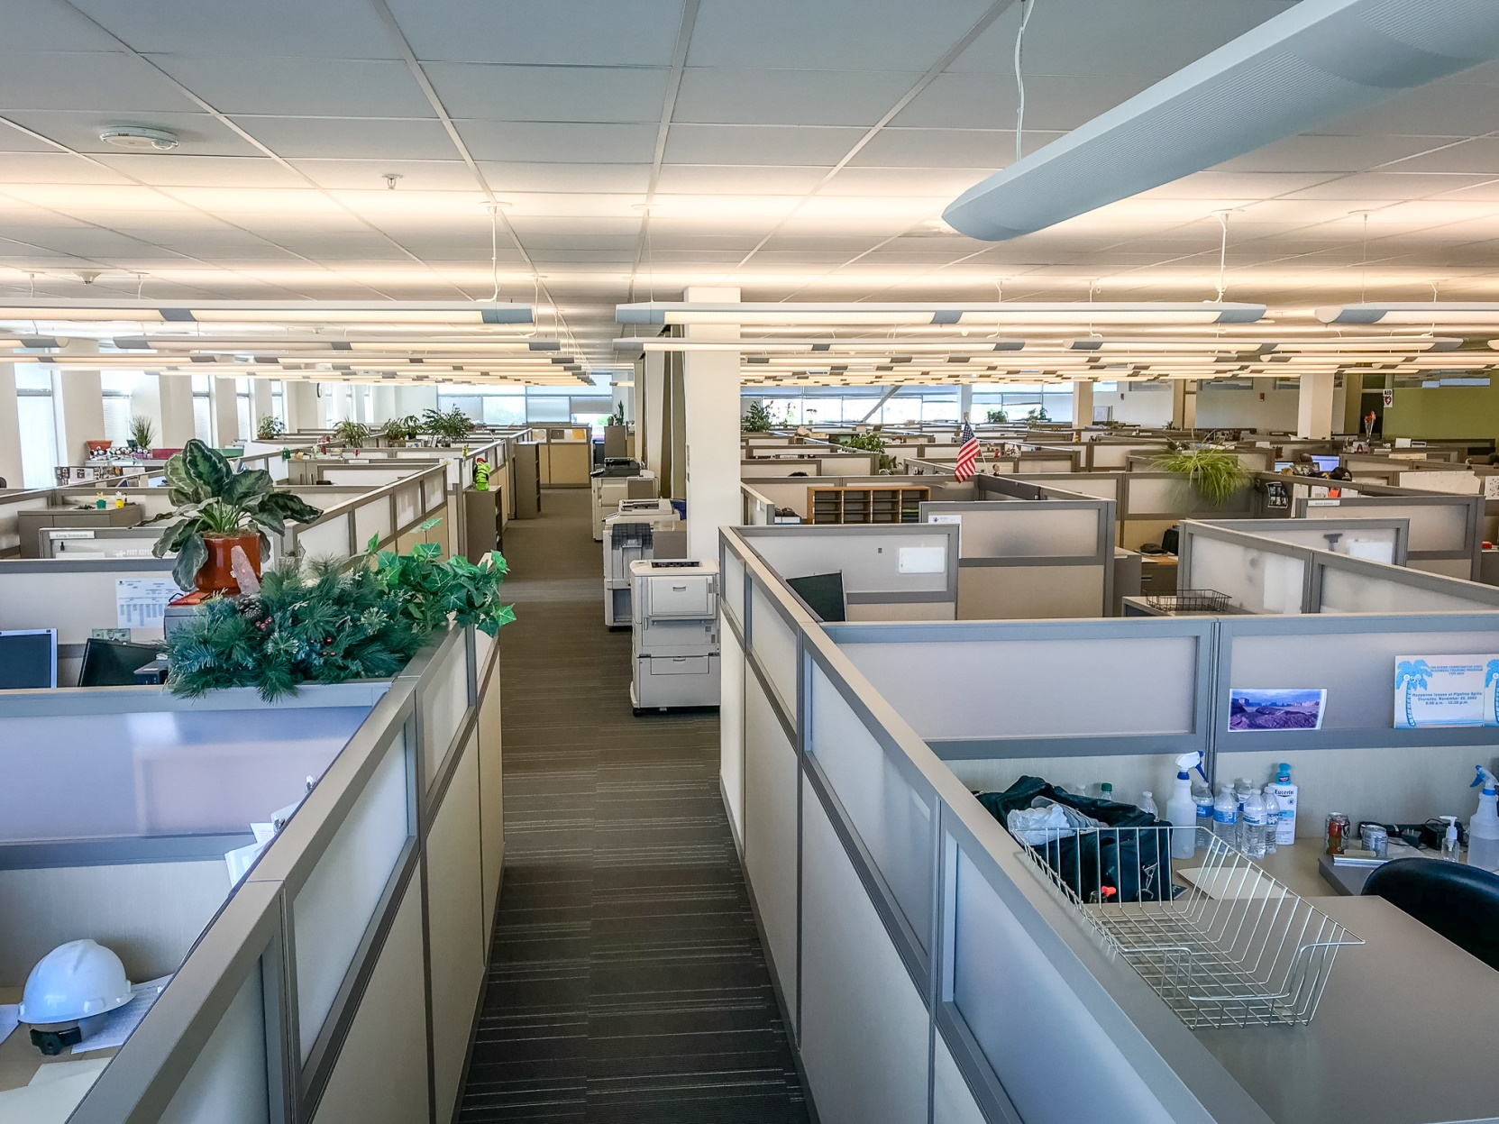
Observations
MASOB is the most modern office building audited
Many open office space areas within buildings audited could be improved, both for efficiency and appeal, by making changes to circulation and furniture layout
6 | 13

Slide 20
Alternative Workspace Strategies (AWS)
Utah Department of Agriculture
No
AWS Program
Conservative
AWS Program
Moderate
AWS Program
Aggressive
AWS Program
159 PEOPLE
56,488 ft²
$28,200,000
159 PEOPLE
49,446 ft²
$24,500,000
159 PEOPLE
46,322 ft²
$23,200,000
159 PEOPLE
42,923 ft²
$21,500,000
7 | 13

Slide 21
Programmed Floors | 4
GSF (entire space within outside walls) | 56,275
Adjusted GSF (excludes voids) | 54,892
RSF (Adjusted minus walls, columns) | 49,658
USF/NSF (RSF minus circulation & mech) | 29,843
Closed offices (SF) | 7,279
Closed offices (count) | 51
Open offices (SF) | 6,209
Open offices (count) | 62
Unused workstations (count) | 2
Workstation guest seats (count) | 0
Support space (SF) | 9,420
Support space seats (count) | 54
Specialty care (SF) | 4,604
Specialty workstations (count) | 8
Collaboration space (SF) | 2,331
Collaboration space seats (count) | 125
Building support spaces (SF) | 19,815
Not audited (SF) | 0
Reported building occupancy | 103
Observed workstation occupancy | 111
Observed workstation capacity | 113
Net : gross ratio | 0.54
Grossing factor | 1.84
Open : closed workstation ratio | 1.22
Avg. SF/private workstation | 142.73
Avg. SF/open workstation | 100.15
Avg. SF/collaboration seat | 18.65
NSF/occupant | 268.86
NSF/capacity | 264.10
RSF/occupant | 447.37
GSF/occupant | 494.52
Total office space/occupant | 121.51
Office support space/occupant | 84.86
Collaboration space/occupant | 21.00
Building support space/occupant | 178.51
% unused workstations | 0.02
% SF closed office space | 14.7%
% SF open office | 12.5%
% SF support space | 19.0%
% SF specialty space | 9.3%
% SF collaboration | 4.7%
$ SF building support | 39.9%
% SF not audited | 0.0%
Space Audit Results
UDAF William Spry Building
8 | 13

Slide 22
Phase Two
Phase Three
Phase Four
Write state policy and standards for space utilization with agency partners
Implement state policies and standards for space utilization through renovation
Provide ongoing management of the standard and conduct additional building audits
9 | 13
Notes:
Conduct study to understand possible alternate workplace arrangement strategies such as hoteling, desk sharing, and telecommuting

Slide 23
What’s Next?
continue auditing effort
make changes to spaces
enforce standard over time
10 | 13

Slide 24
Cost of Renovating 3 State Buildings
Building | Estimated Renovation Cost | Gross Square Ft. | Current Utilization | Estimated Additional People Housed by AWS Program | Cost for New Construction | Savings for Renovation vs New Construction
Cannon Health Building | $25,041,785 | 182,293 | 50% | 112 | $91,146,500 | $66,104,715
DNR Building | $24,389,896 | 171,519 | 45% | 98 | $85,759,500 | 61,369,604
1385 S. State DWS | $10,639,055 | 66,032 | 54% | 38 | $33,016,000 | $22,376,945
SUBTOTAL | $60,070,736 | 419,844 |  | 248 | $209,922,000 | $149,851,264
5 years of leased space | $3,060,000
TOTAL COST | $63,130,736
11 | 13

Slide 25
Renovation Schedule
Cannon Health
1.75 years
(91 weeks)
1385 DWS
1.67 years
(87 weeks)
DNR
1.67 years
(87 weeks)
12 | 13

Slide 26
Questions
13 | 13

